Slide 1
Case Study Miami Dade County
August 20, 2018

Slide 2
Objectives
Quantify the effect of groundwater pumpage from the Biscayne aquifer on canal leakage throughout the urban areas of the county for all of the well fields operated by the Miami-Dade County Water and Sewer Department
Determine how canal leakage may change in response to increased groundwater pumpage and increases in sea level
Determine how increased groundwater pumpage may change groundwater seepage from the Everglades.

Slide 3
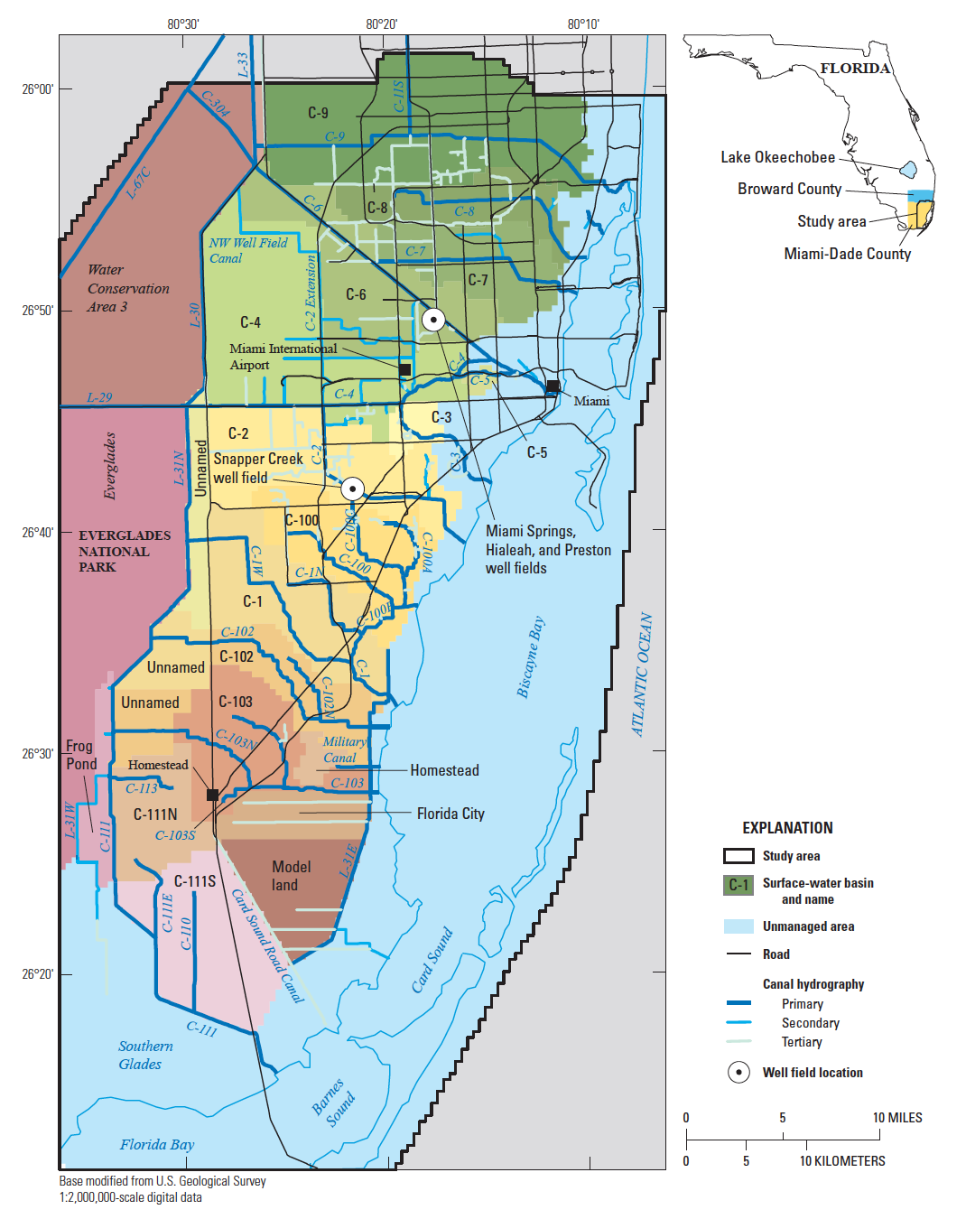
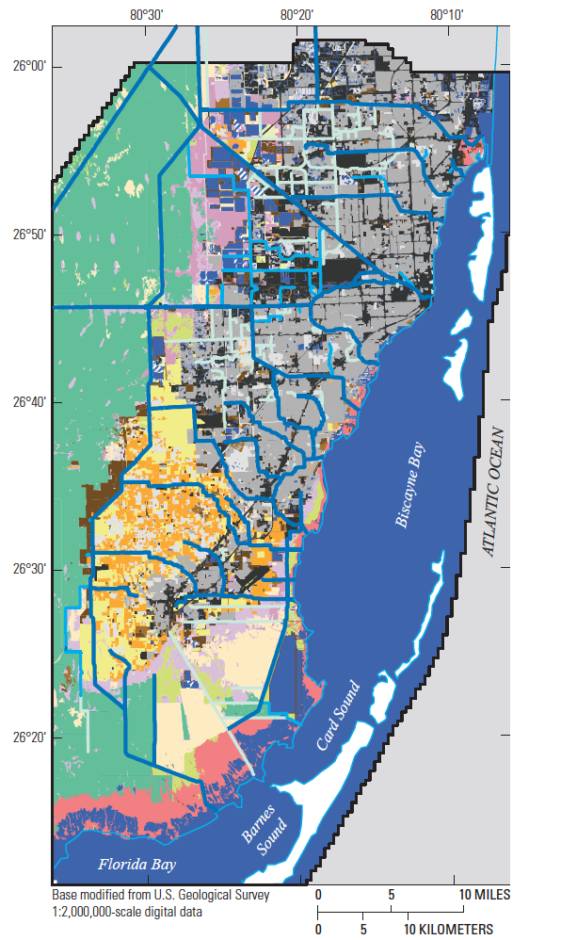
Study Area

Slide 4
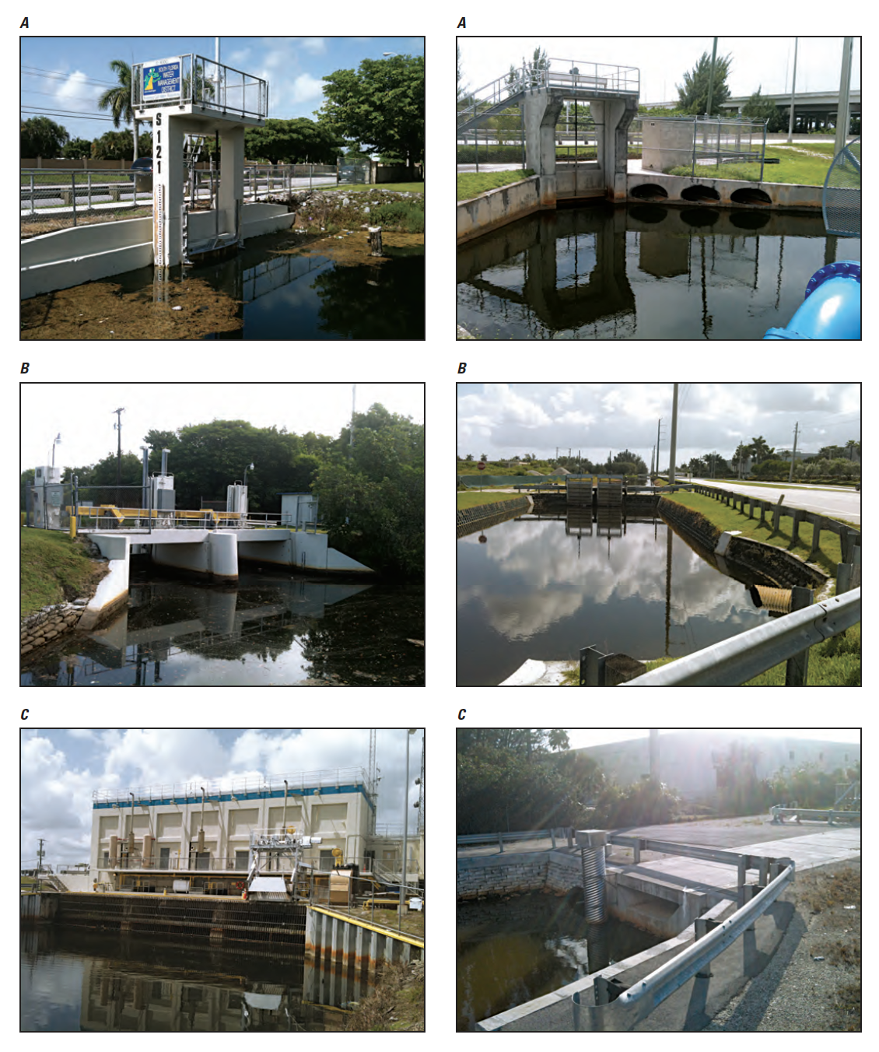
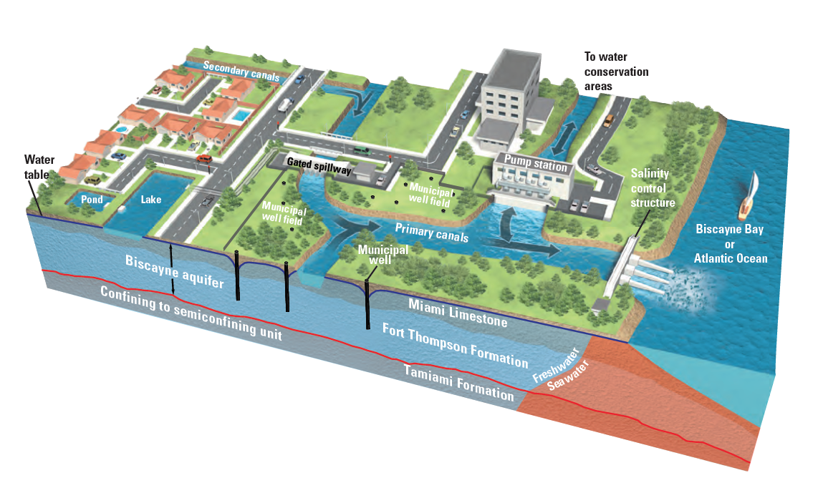
Surface-water Flow

Slide 5
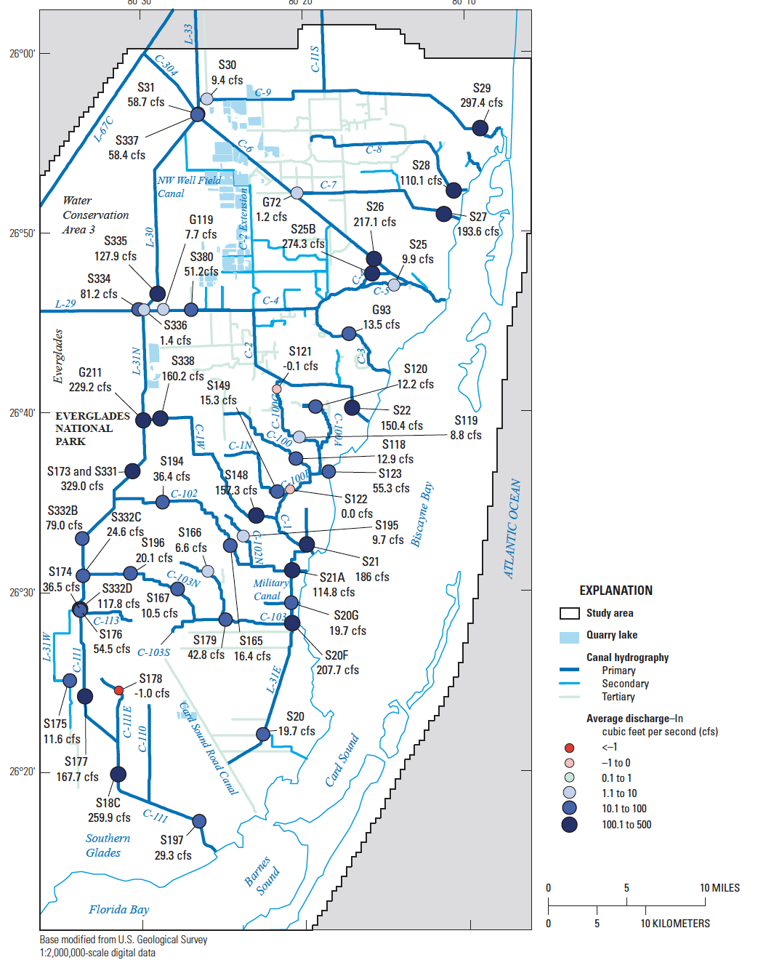
Surface-water Flow

Slide 6
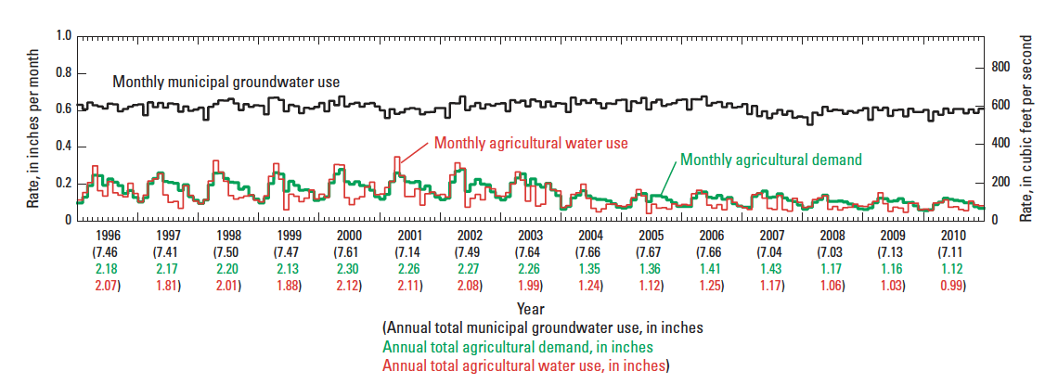
Water Use

Slide 7
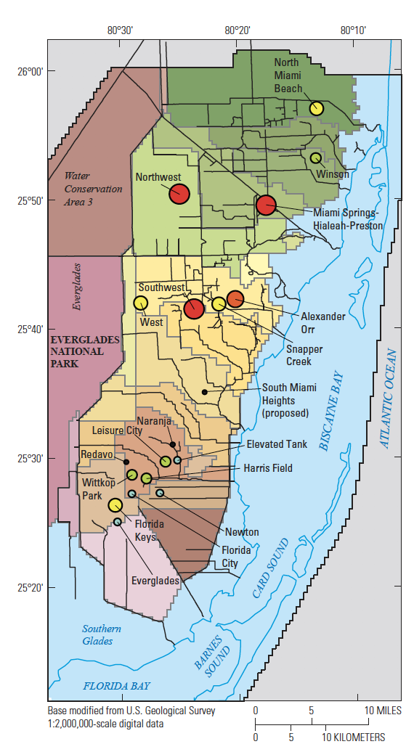
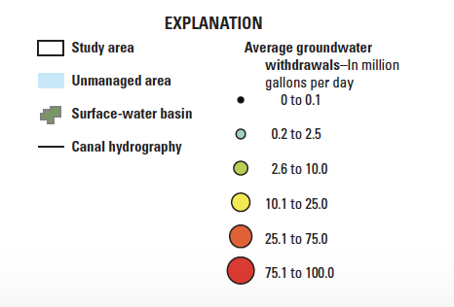
Water Use

Slide 8
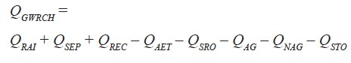
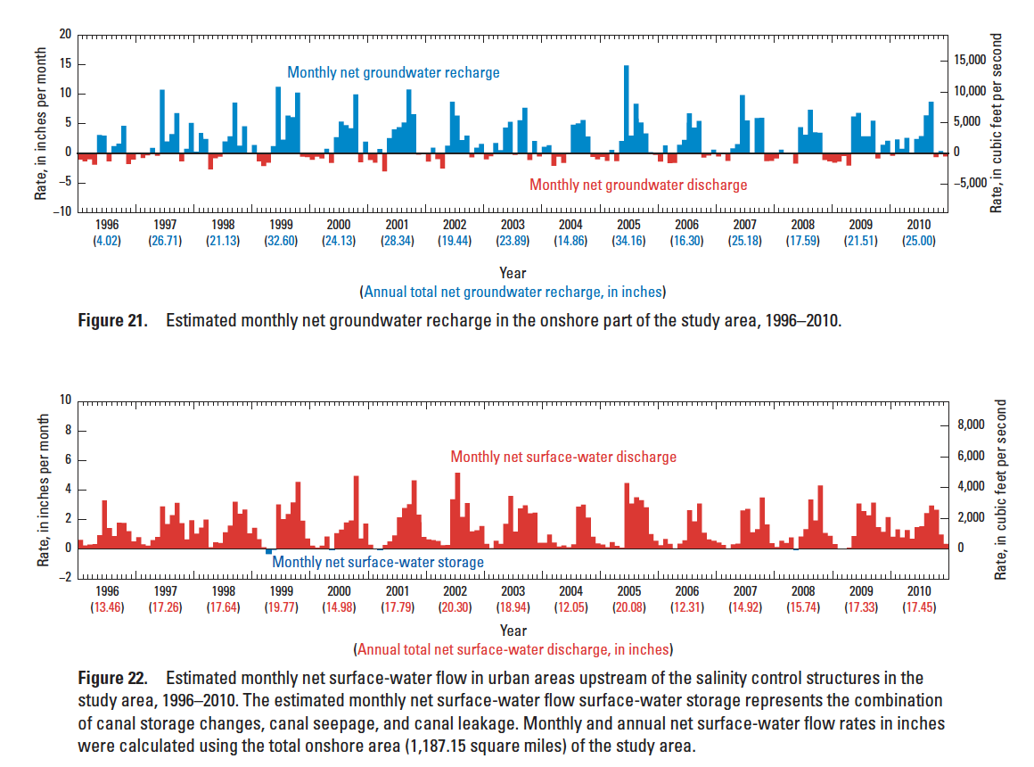
Groundwater Recharge

Slide 9
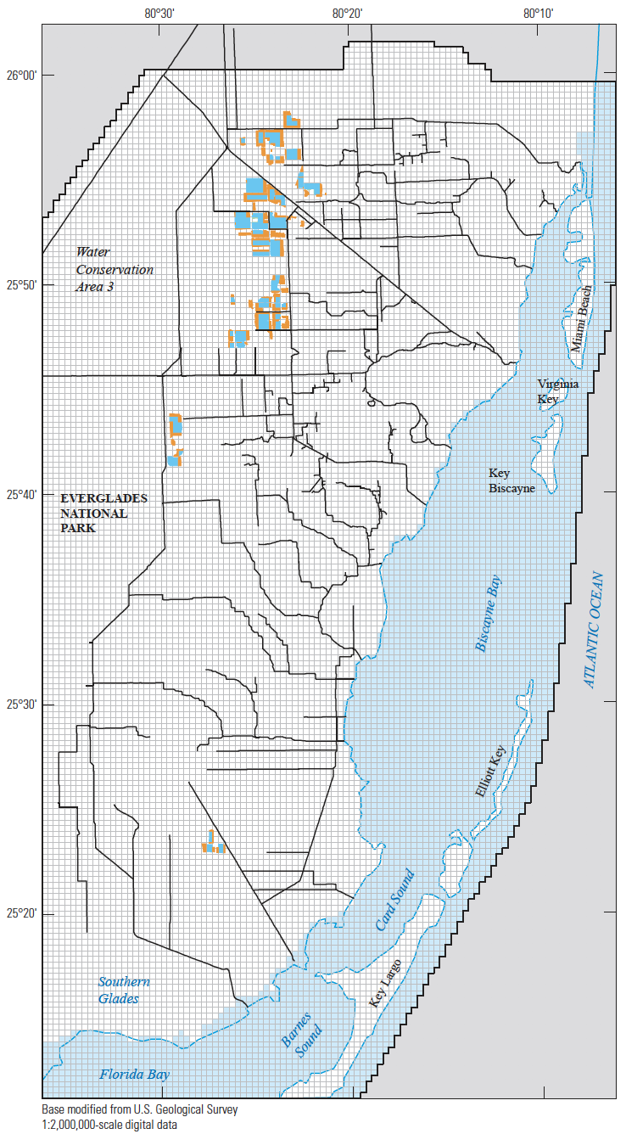
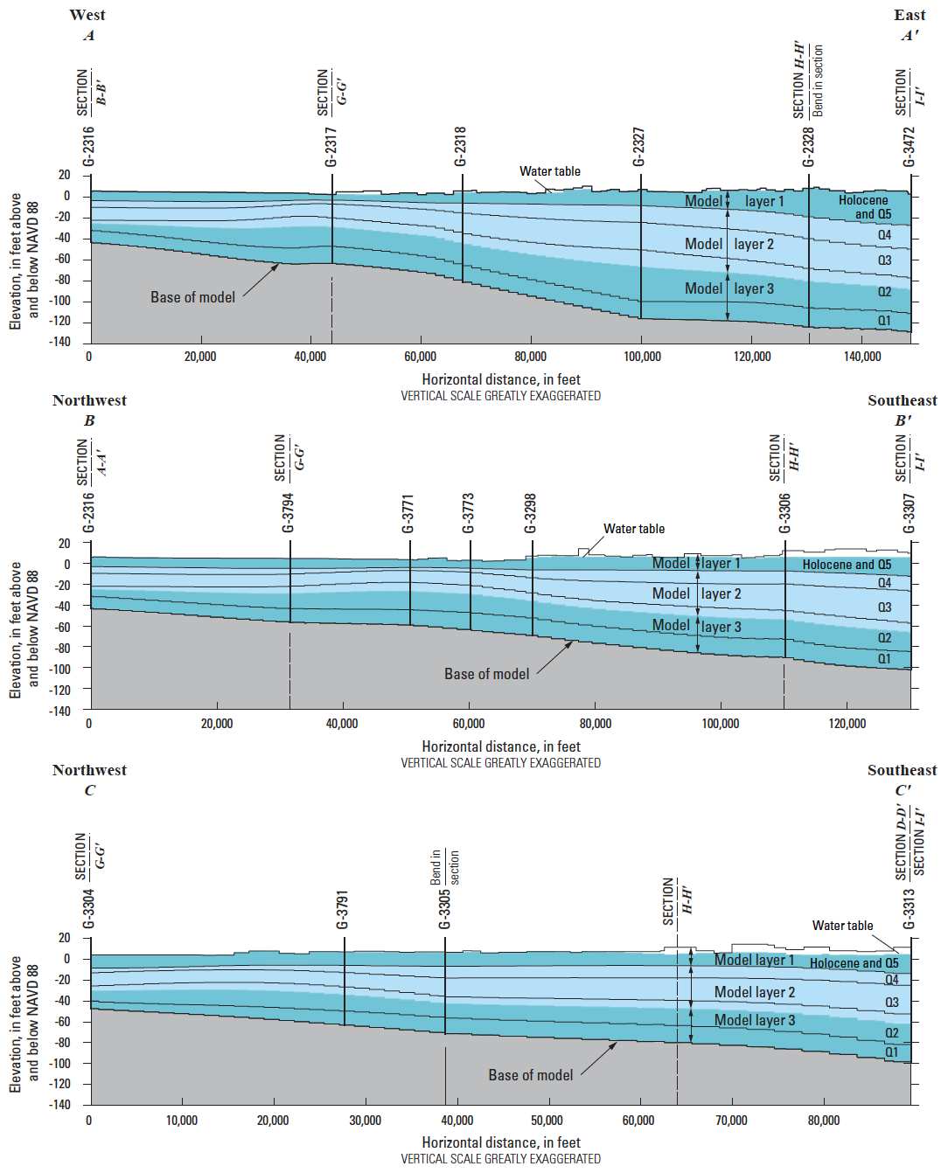
Model Setup

Slide 10
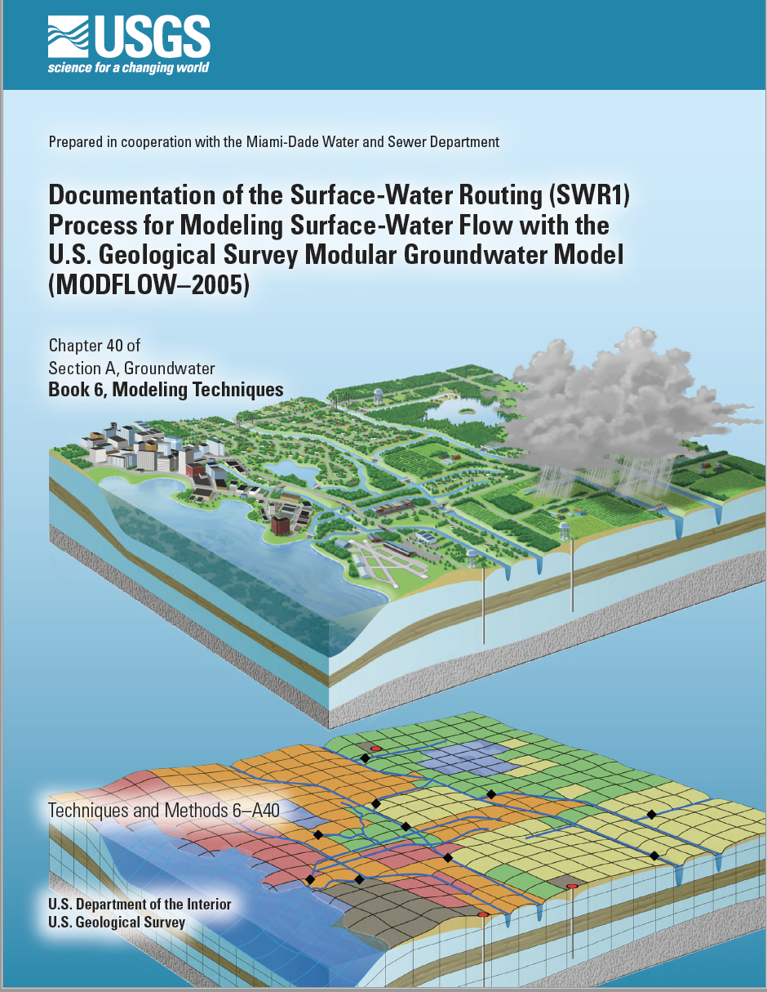
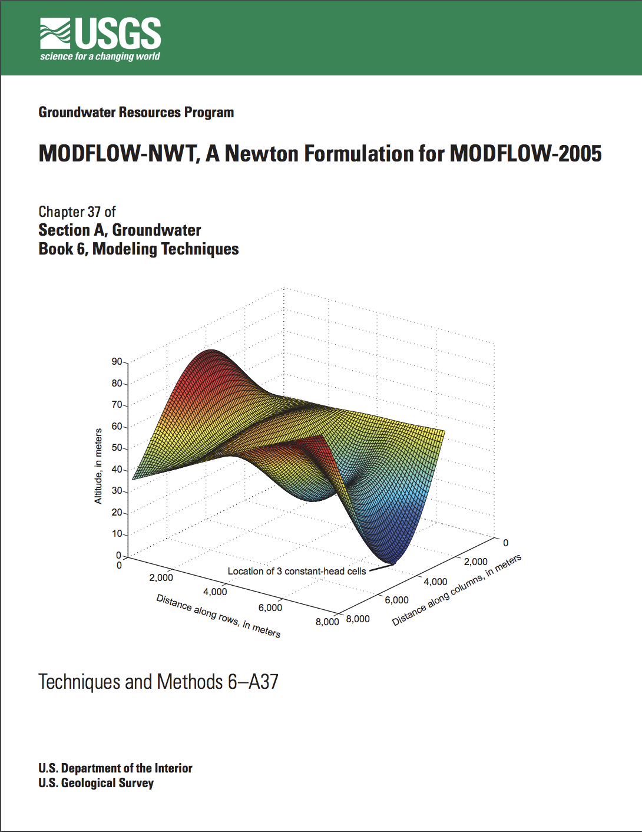
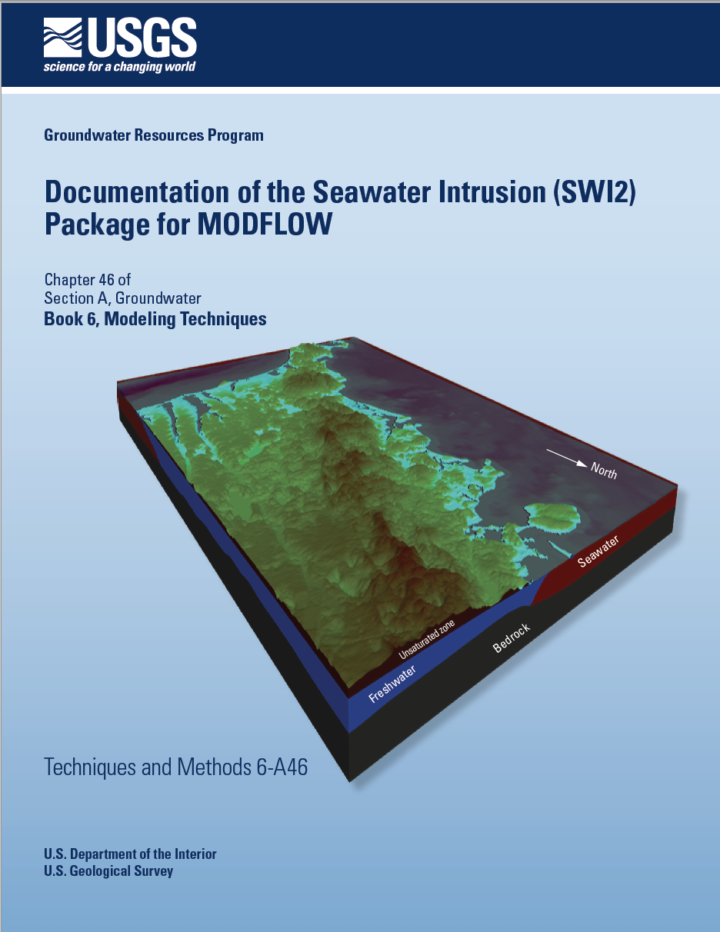
Model Setup

Slide 11
Model Setup

Slide 12
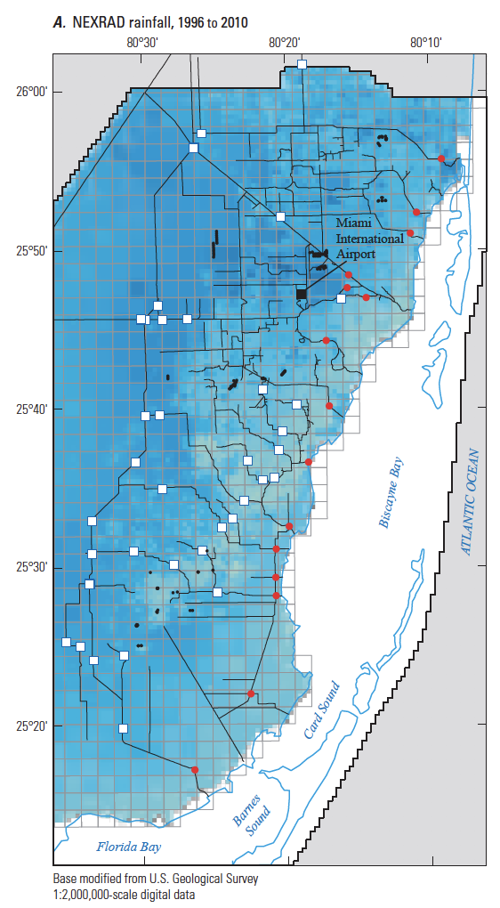
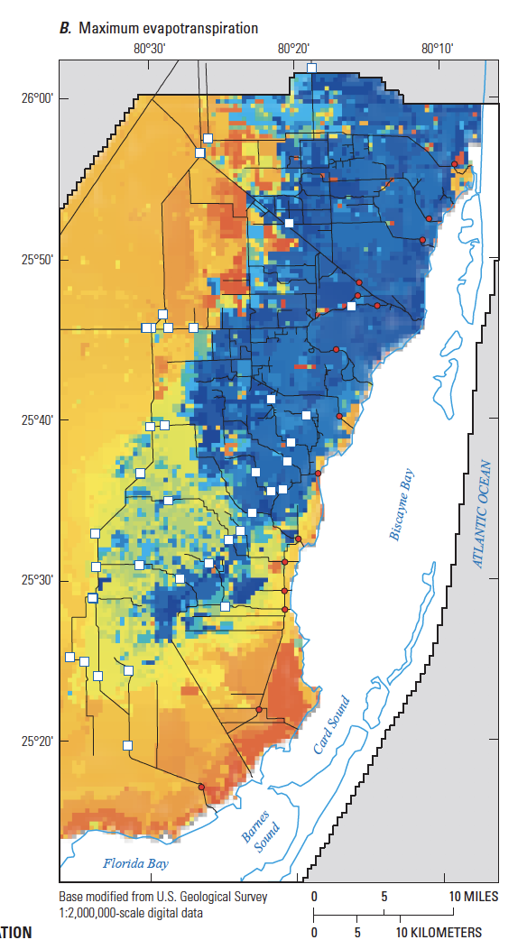
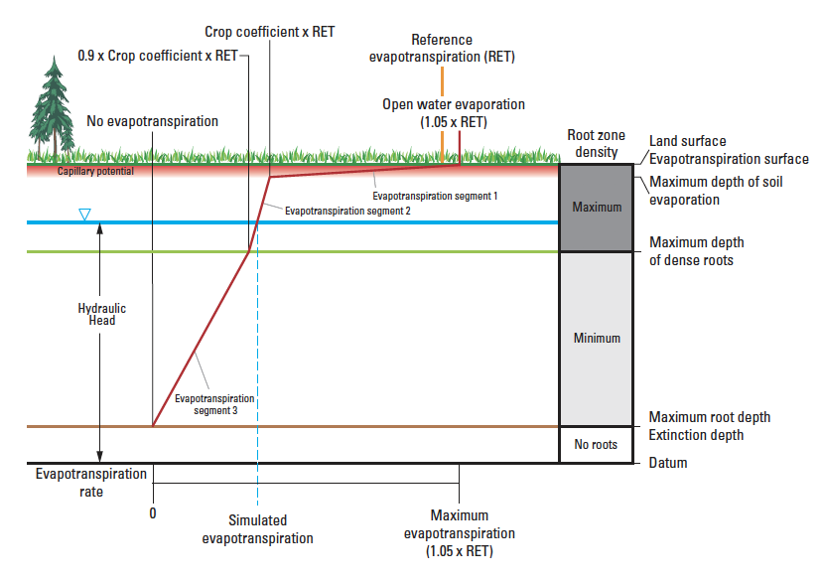
Model Setup

Slide 13

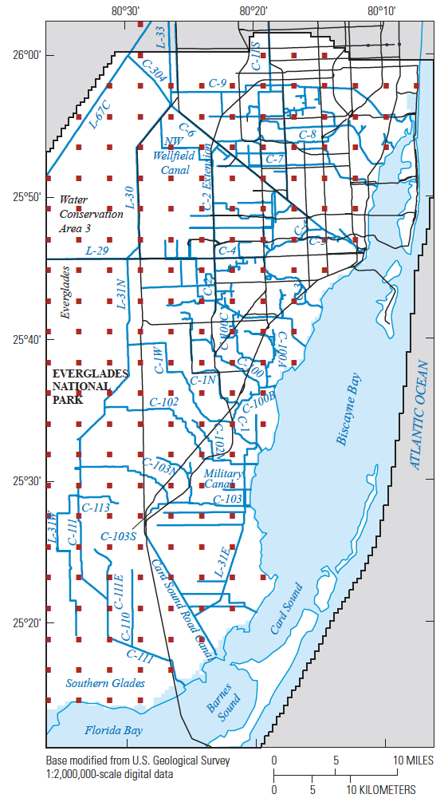
Model Calibration

Slide 14
Model Calibration
Hydraulic conductivity (UPW package)
Specific yield of layer 1 (UPW package)
Specific storage of layers 1-3 (UPW package)
Extinction depth (ETS package)
Depth of dense roots (ETS package)
Monthly crop coefficients (ETS Package)
Leakance coefficient (SWR Process)
Manning’s roughness coefficients (SWR Process)
3,669 total parameters estimated during calibration

Slide 15
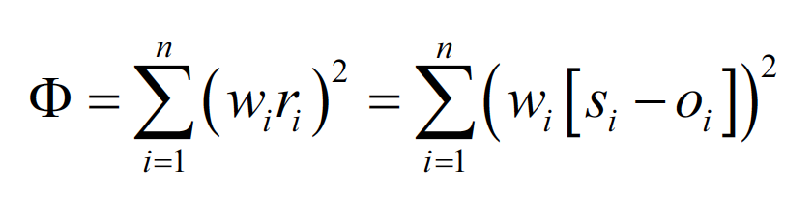
Model Calibration

Slide 16
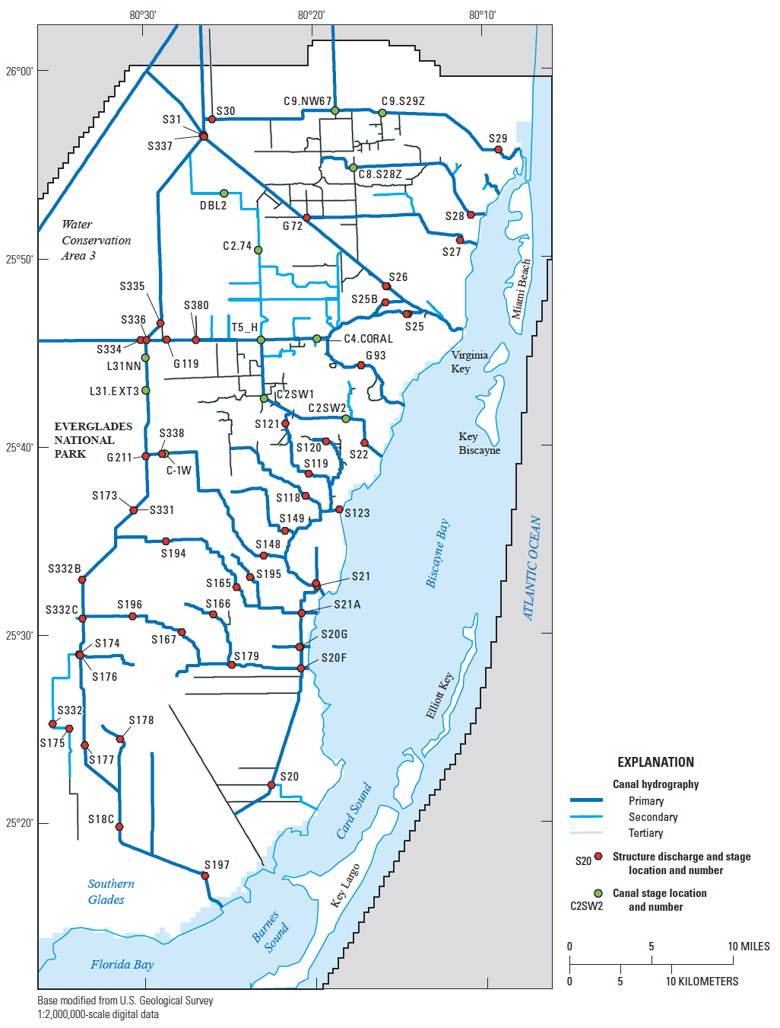
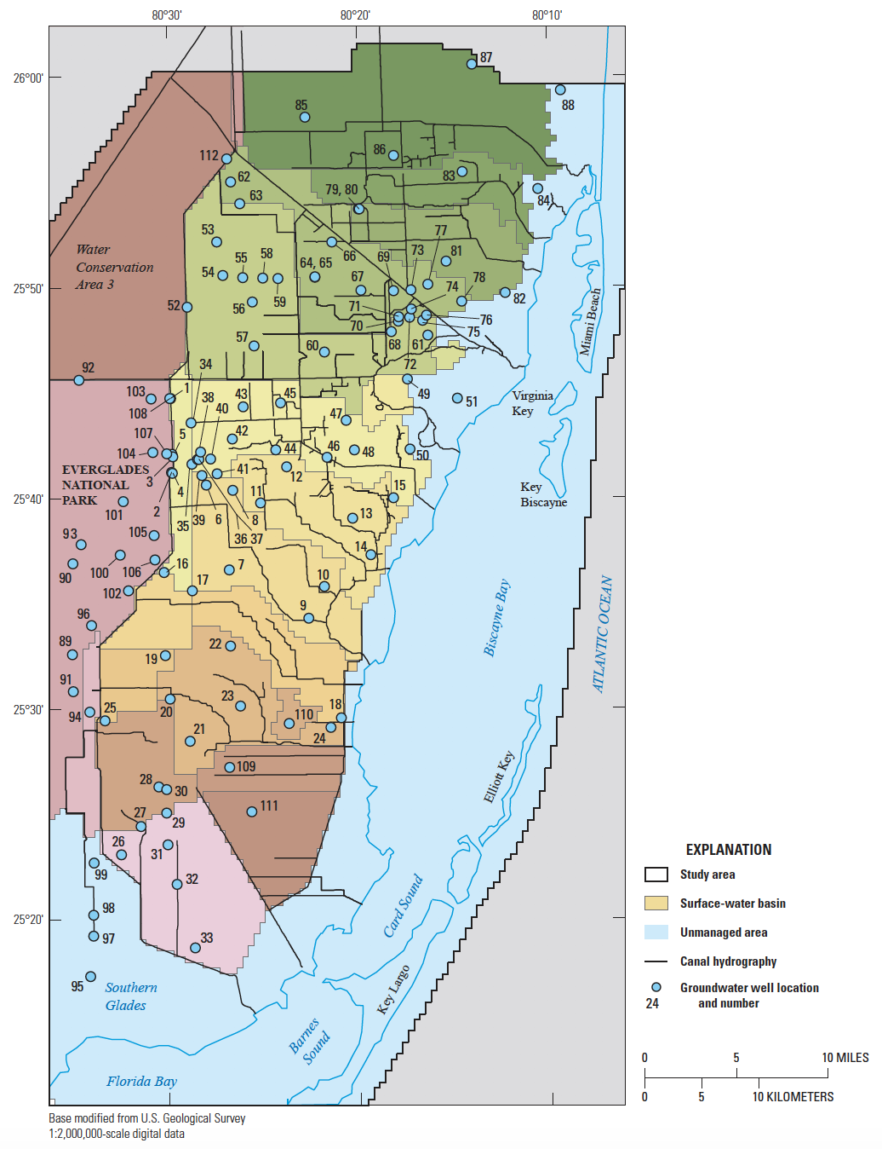
Model Calibration

Slide 17
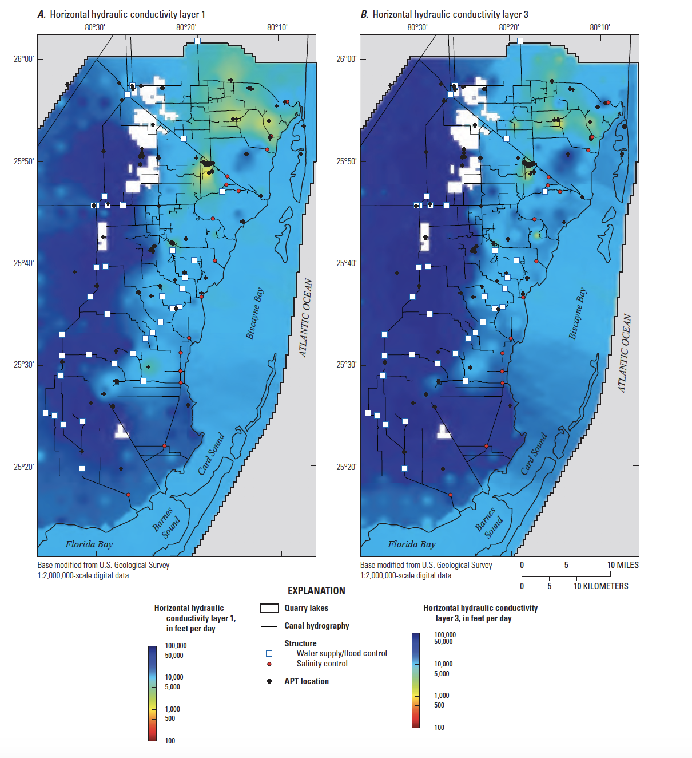
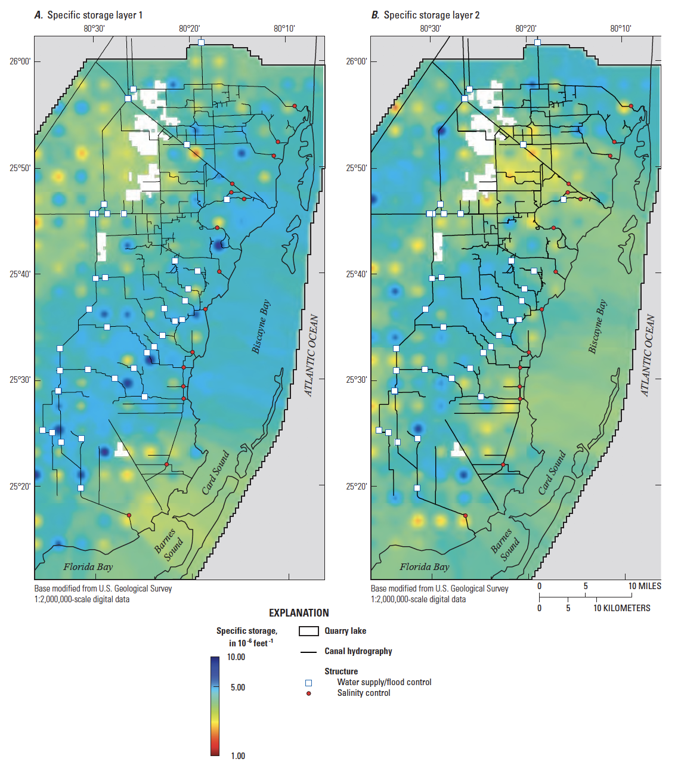
Model Calibration

Slide 18
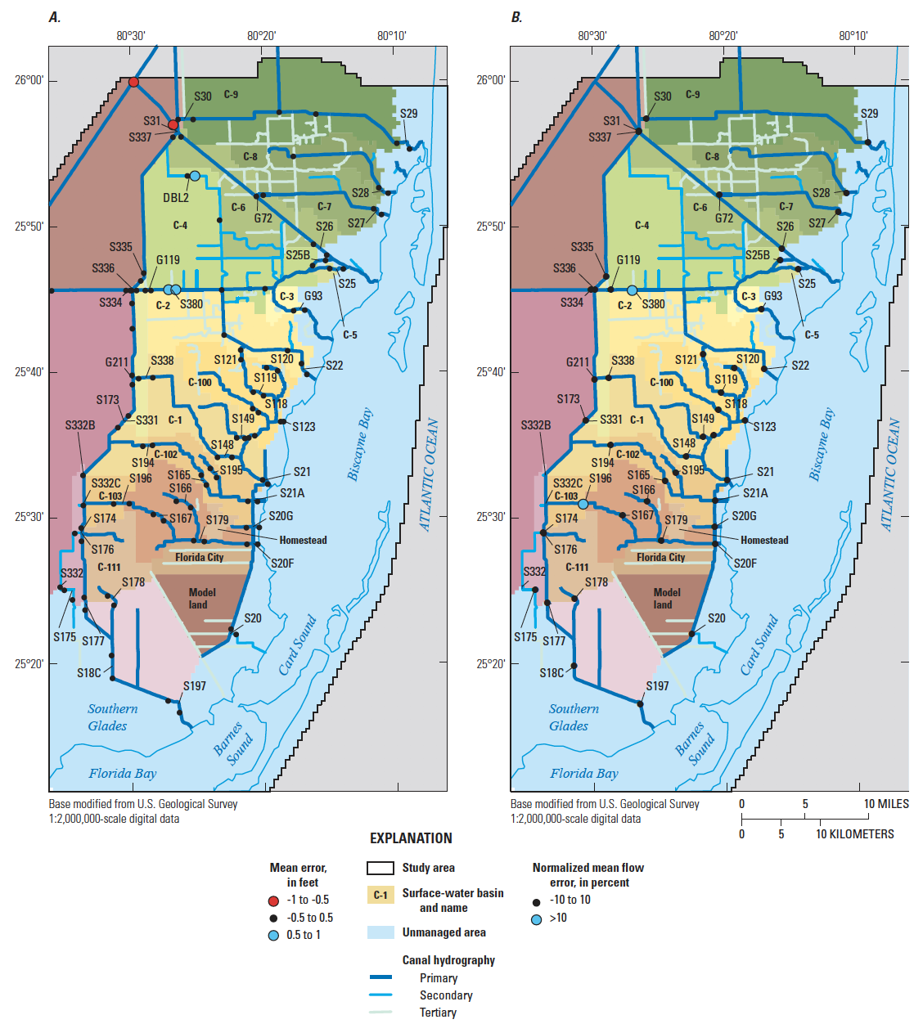
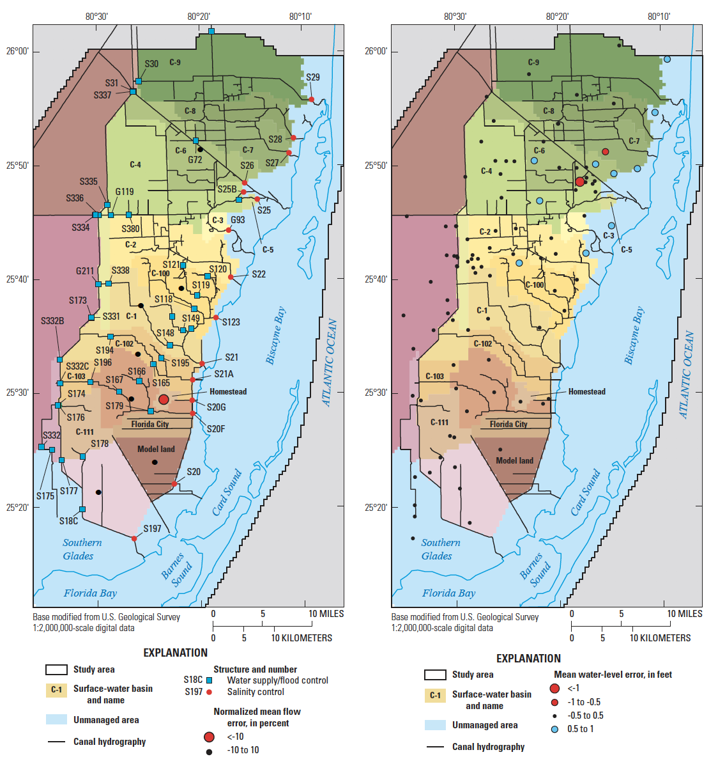
Model Calibration

Slide 19
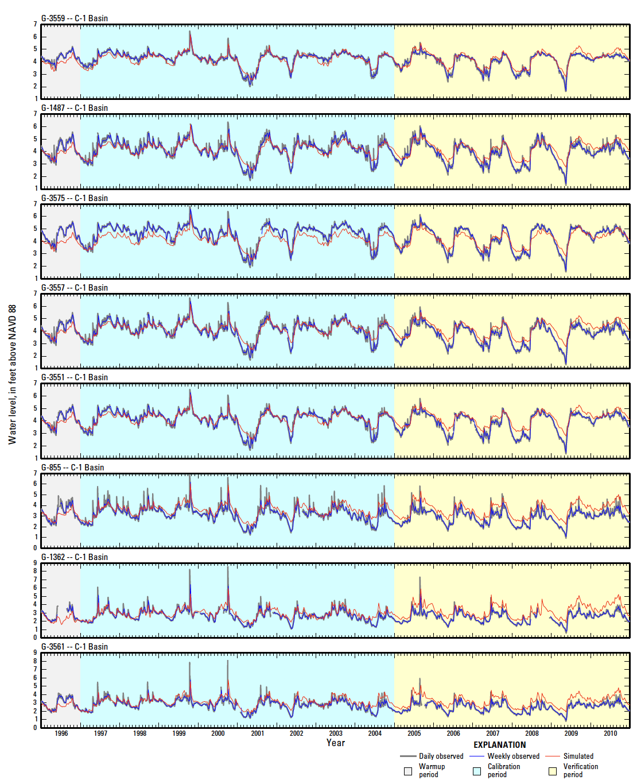
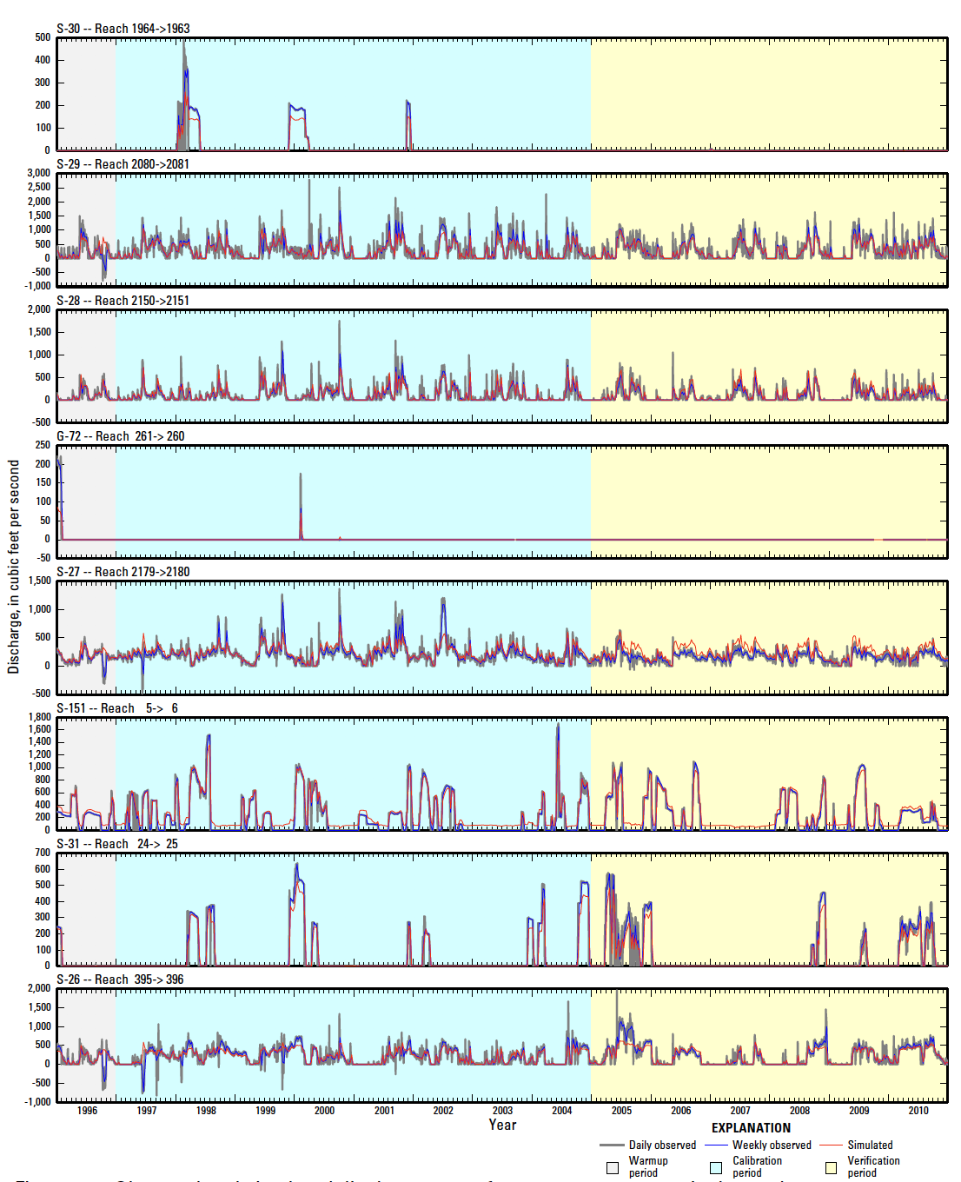
Model Calibration

Slide 20
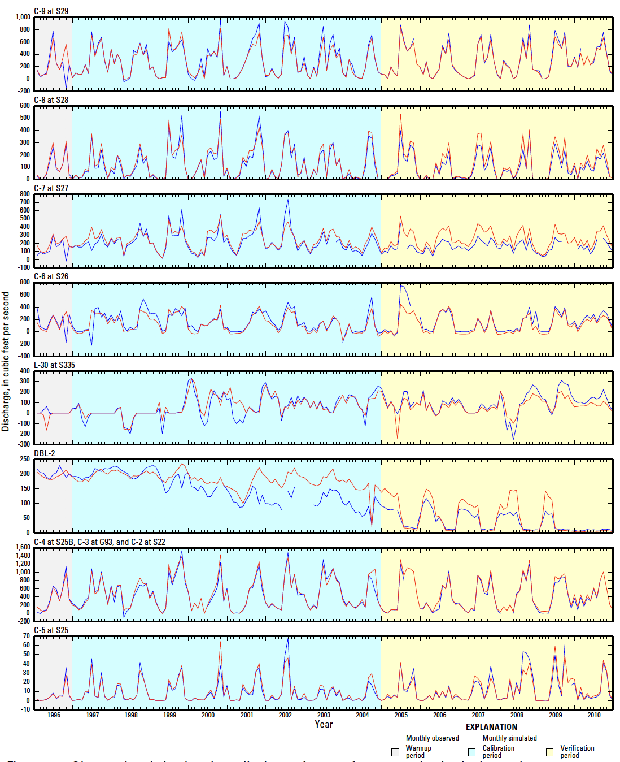
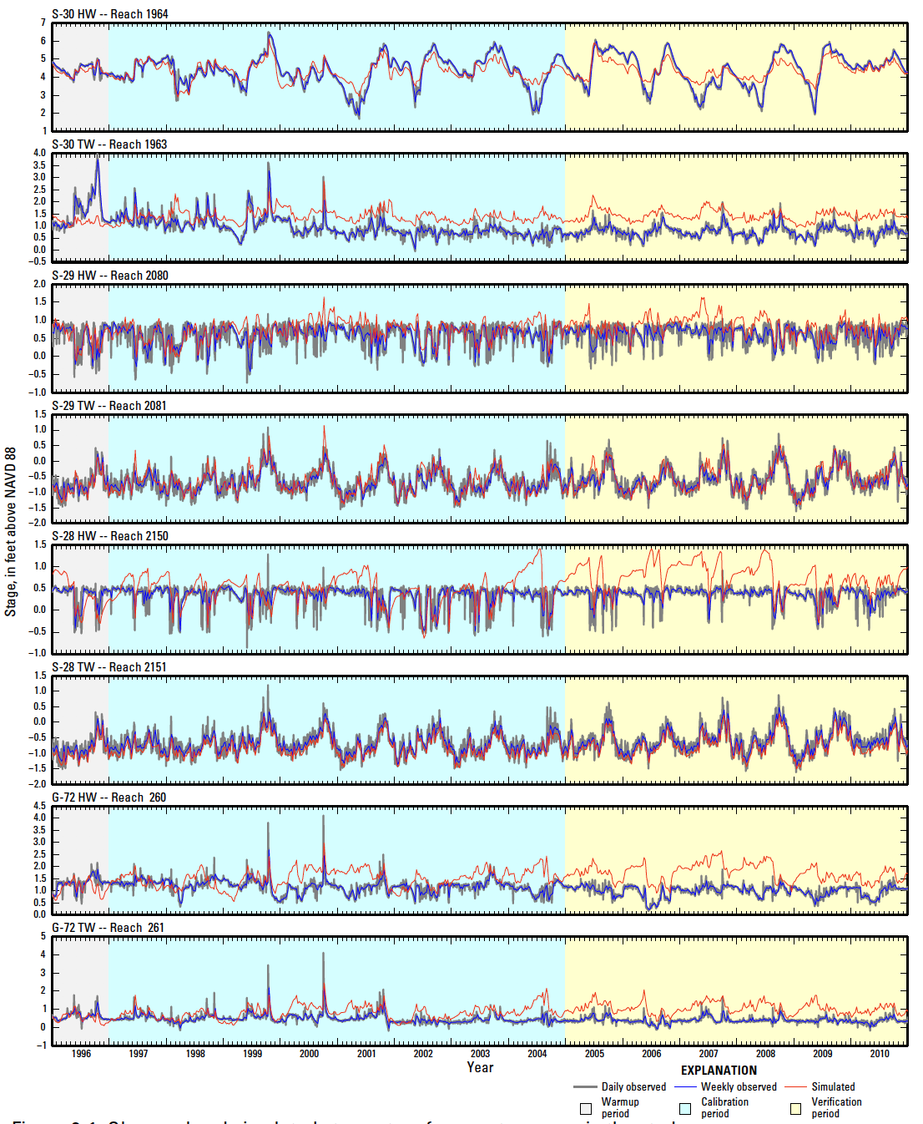
Model Calibration

Slide 21
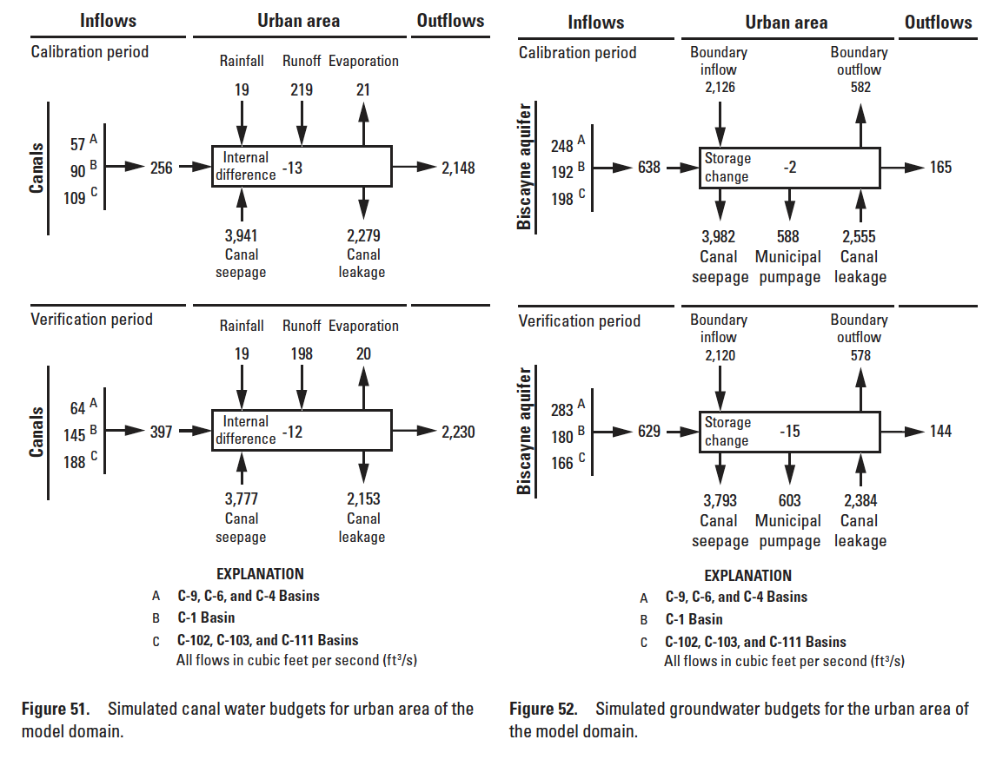
Model Results

Slide 22
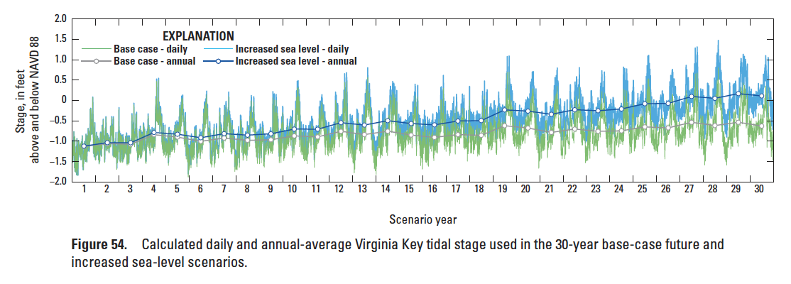
Model Scenarios

Slide 23
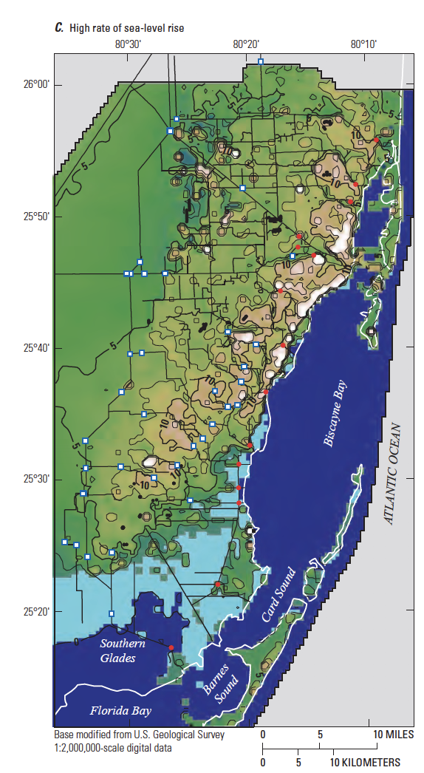
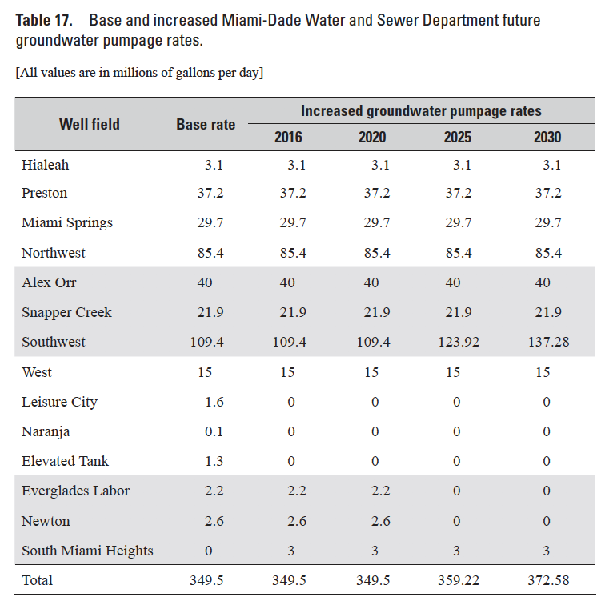
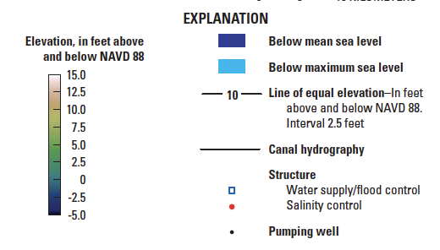
Model Scenarios

Slide 24
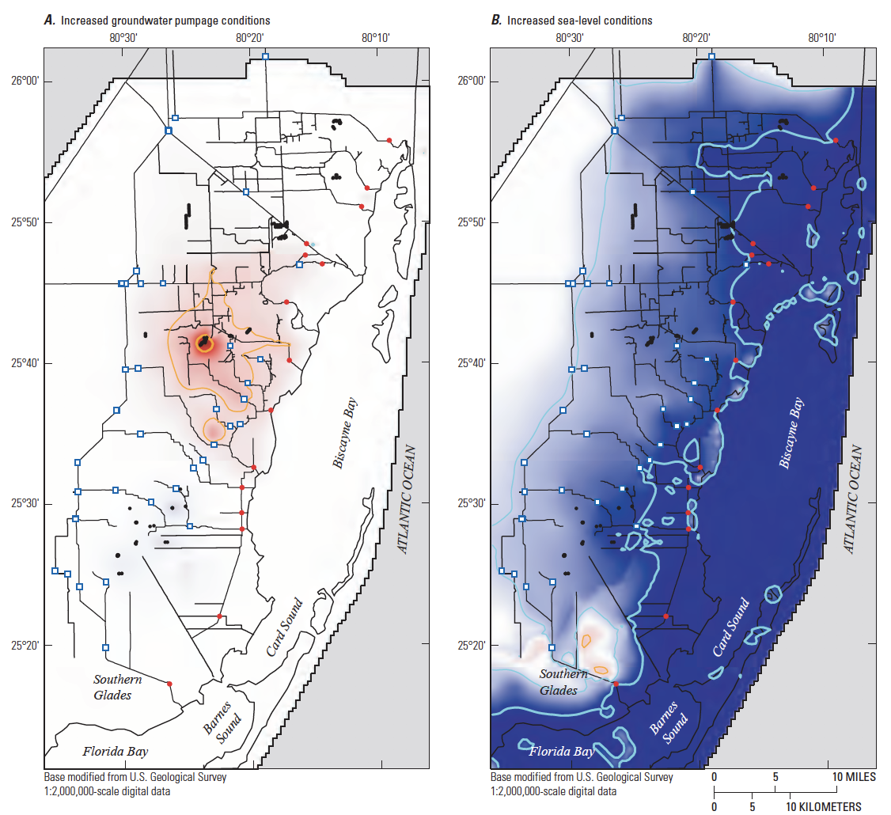
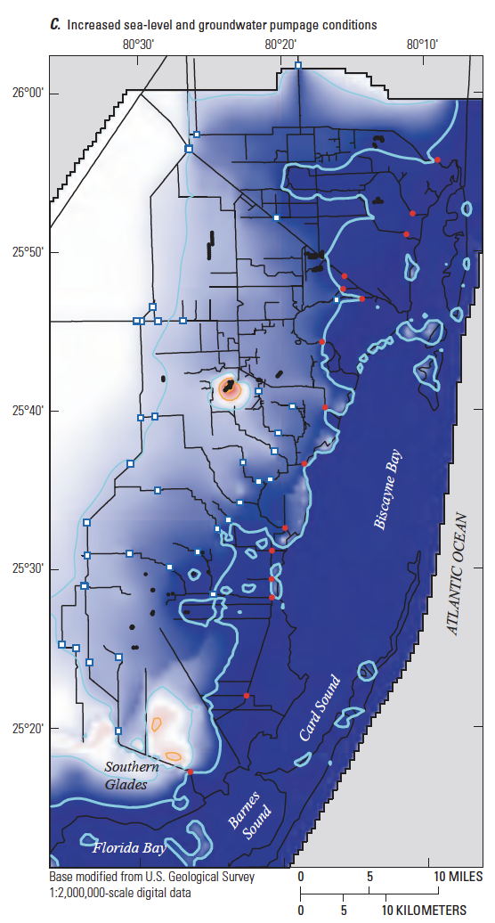
Model Scenarios

Slide 25
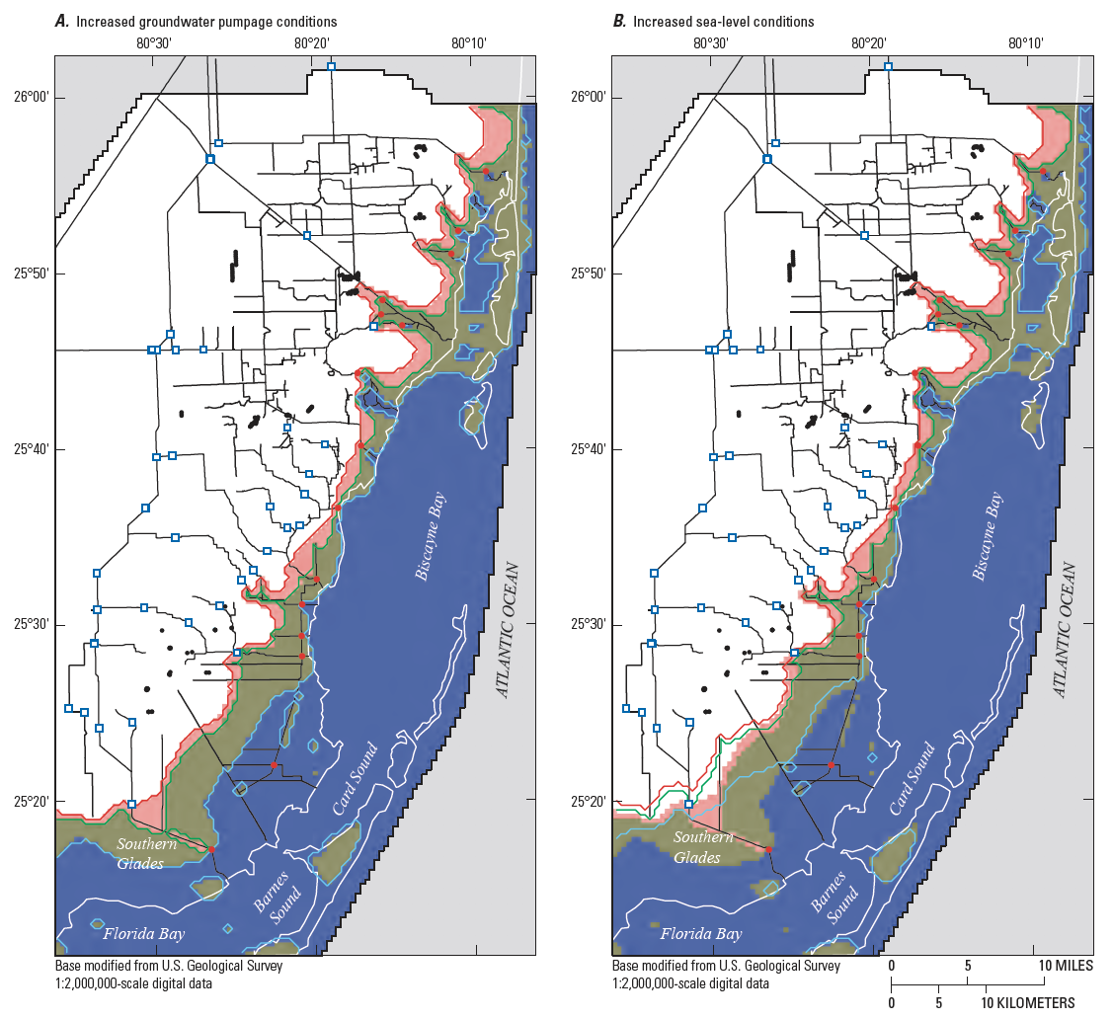
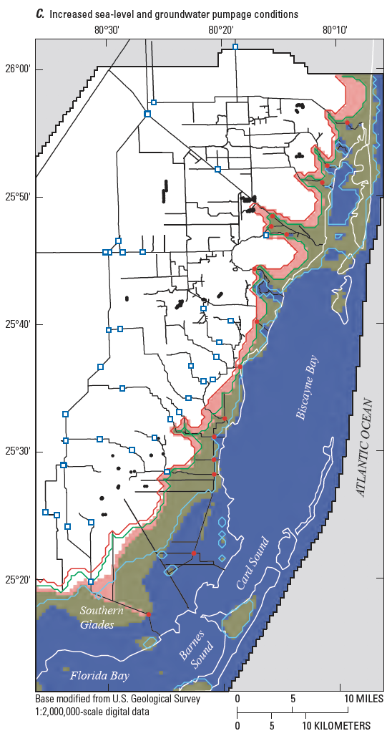
Model Scenarios

Slide 26
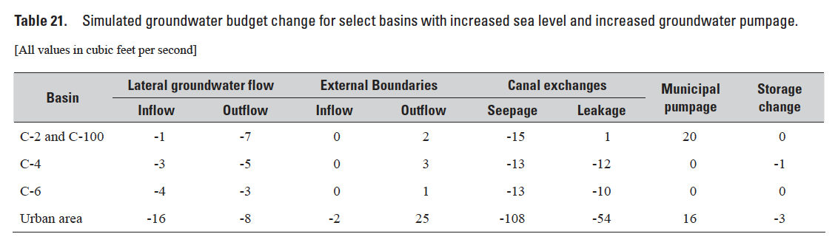
Model Scenarios

Slide 27
Conclusions
Canal and aquifer water budgets for urban areas indicate that most of the water discharging through the salinity control structures is derived from groundwater inflow within the urban parts of the study area
On average, the canals are draining the Biscayne aquifer
Groundwater discharge from the urban areas to the coast is approximately 7 percent of the total surface-water inflow to Biscayne Bay
Groundwater pumpage ranges from 13 to 27 percent of local sources of groundwater recharge
Simulations show that the canal system limits the adverse effects of proposed groundwater pumpage increases
Proposed increases in groundwater pumpage did not have a notable effect on the position of the freshwater-seawater interface

